Slide 1
Game Development Project
3D PacMan
20111466 안재혁
20111084 송민석
20115725 안준형

Slide 2

Game introduction
Game Tool
Game Feature
Demo
INDEX

Slide 3
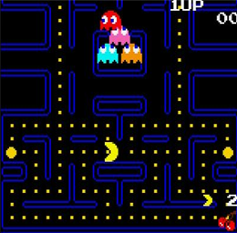
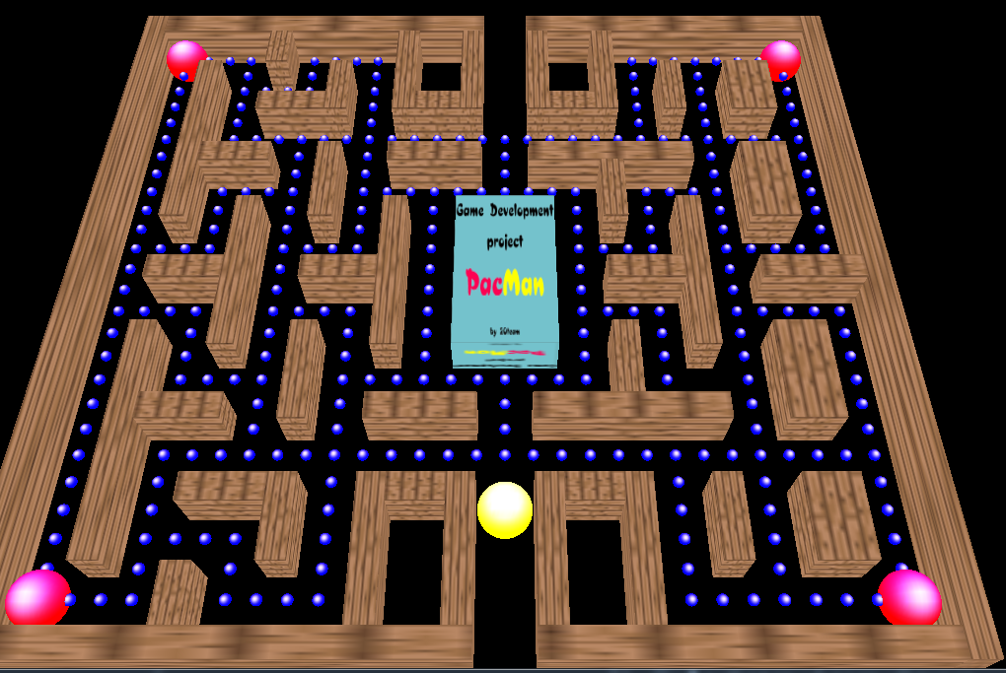
1. Game Introduction
01
3D PacMan
02
03
04
2D
3D

Slide 4


2. Game Tool
01
Game Tool
02
02
03
04

Slide 5
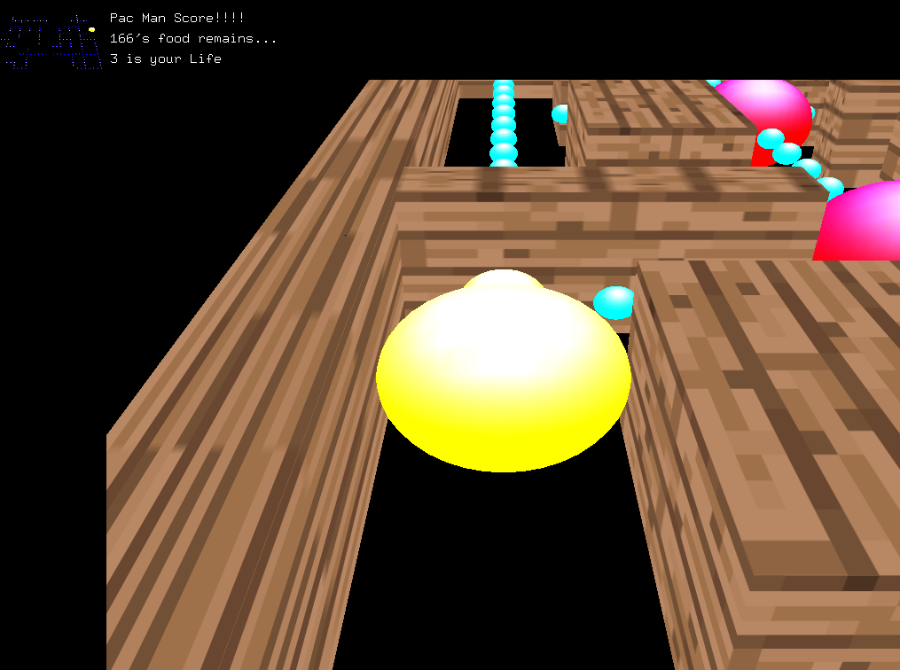
3. Game Feature
01
Game Feature
02
Score & life
03
03
04
Mini Map
Enemy
First person view

Slide 6
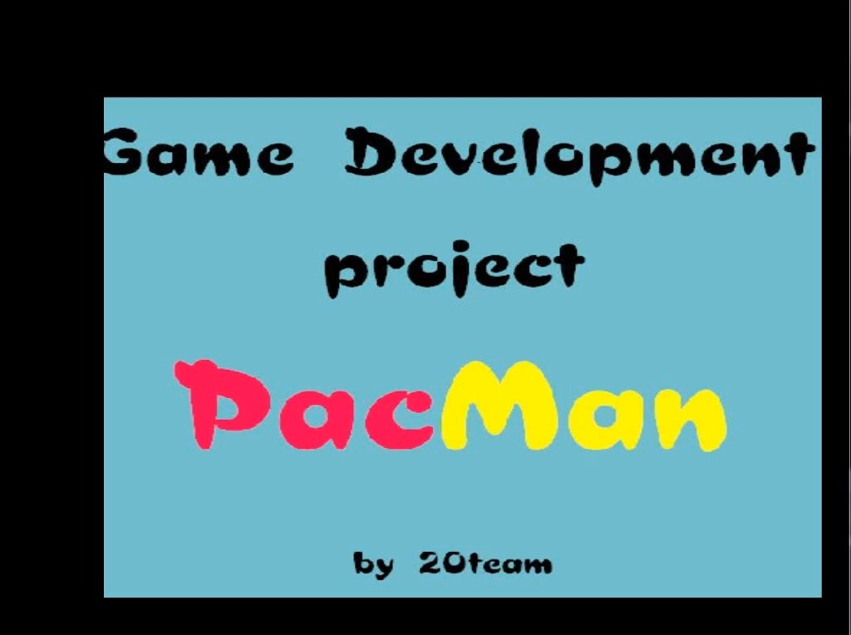
4. Demo
01
Demo
02
03
04
04

Slide 7
Thank you

